Slide 1

Toronto Crime Analysis
Presented By:
Adam Tour
Aditya Parmar
Bowen Pang (Jasper)
Gurpreet Singh Dhameja
Instructor: Madhur Chopra
TA: Ken & Joshua

Slide 2

Project Overview
This project examines different categories for crime data for each of the neighborhoods in Toronto, which all data was retrieved from the Toronto Police Service Public Safety Data Portal
The goal of our project is to help the population visualize crime trends in their neighborhood.
Our dashboard displays interactive charts that show how a particular type of crime occurrence has changed over a range of years, the distribution of crimes in a given neighborhood, and how that neighborhood ranks among all neighborhoods based on the chosen crime.

Slide 3

Agenda
TORONTO CRIME ANALYSIS
What types of crime are most prevalent in each neighborhood?
Which neighborhoods would be considered the safest based on certain types of crime?
How has the occurrence of crime changed in each neighborhood?
Are there crime hotspots or is crime evenly distributed?
3
3

Slide 4
Process and Decision Making
Brainstorm ideas
Finalizing Topic
Task Allocation
Data Collection & Cleaning
Database
Front End
New JS Library added
Consolidate Contribution
Final Review
4

Slide 5
Data Cleaning and Limitations:
TORONTO CRIME ANALYSIS
Data Collection & Cleaning:
Data resource - Toronto Police Service Data Portal
Merged and reorganized
!
Limitations:
Unavailable dataset and missing information in the raw dataset
Different Column Names & Date Format
5

Slide 6
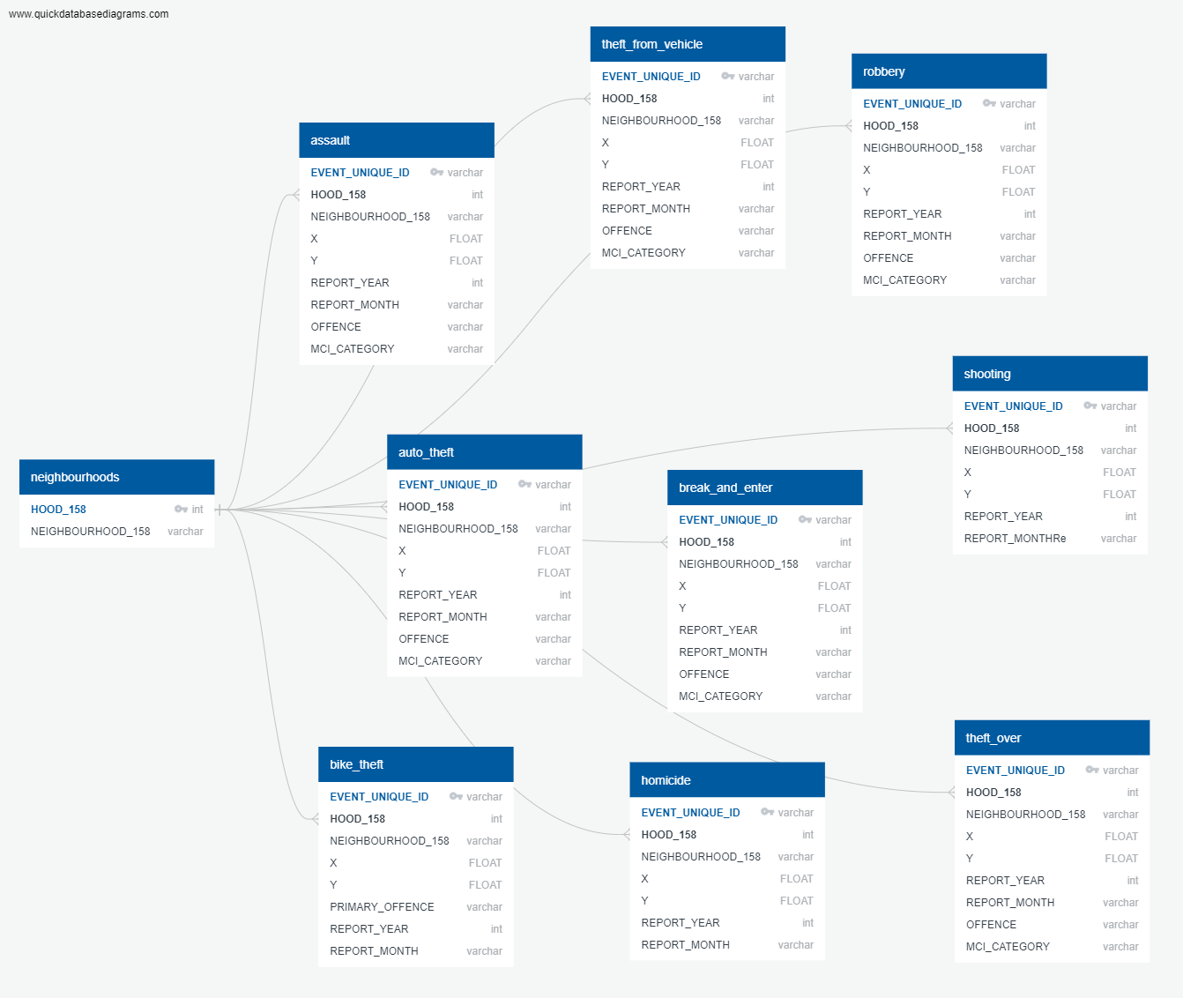
Database And Flask
TORONTO CRIME ANALYSIS
6

Slide 7
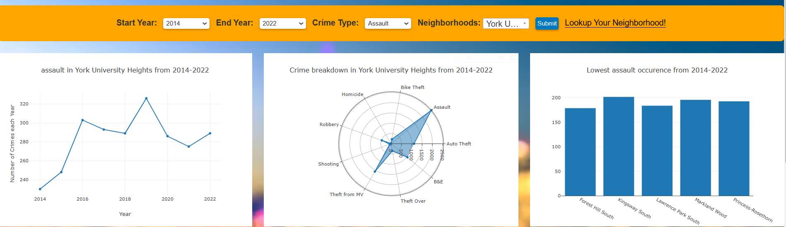
Interactive Graphs:
Graphs:
Line Chart
Radial Chart
Bar Chart
7

Slide 8
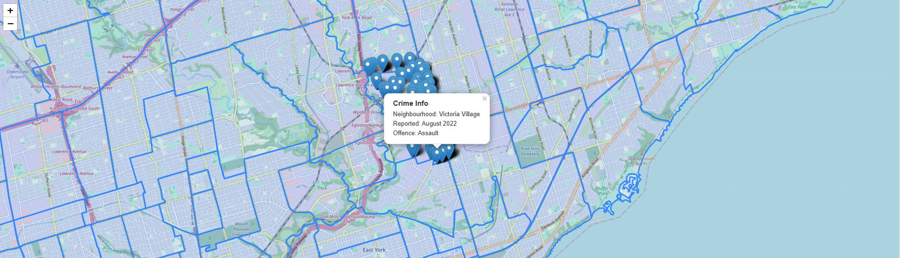
Interactive Map:
Map:
Markers with Crime Information
8

Slide 9
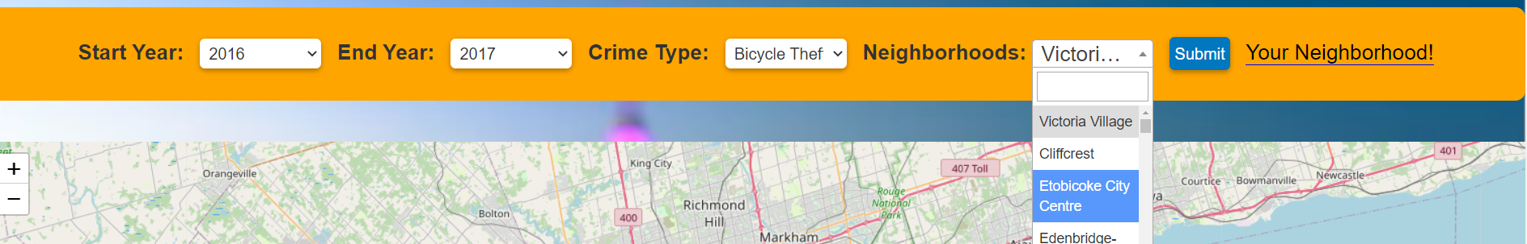
New Library added
Select2 is a popular JavaScript library that enhances the functionality of a standard HTML select element. It provides a user-friendly interface for selecting one or more options from a long list of items. Select2 is built on top of jQuery and is widely used in web applications to improve the user experience of dropdowns.
9

Slide 10
Summary
Analyzing the crime data from the Toronto Police Service.
Includes most of the information like type of crime, location, report time and other relevant details.
We took the latitudes and longitude of each neighborhood in order to mark symbol on the map.
10

Slide 11
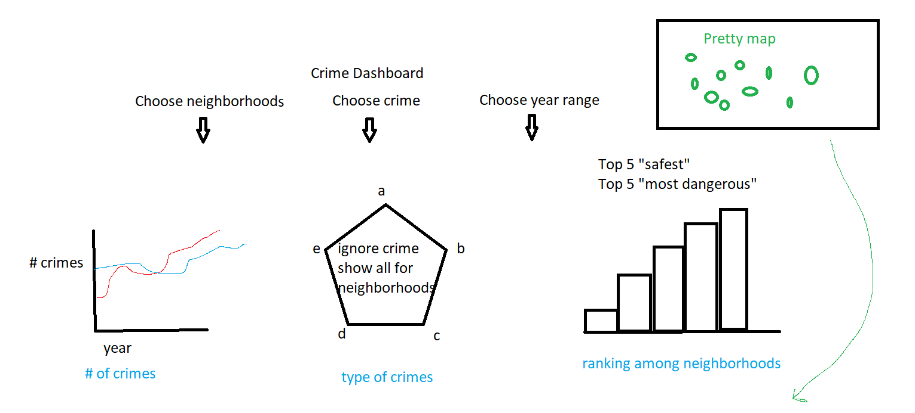
PICTURE WE STARTED

Slide 12




Thank you

